Slide 1
Chapter 4:
Project Scope Management

Slide 2
Importance of Good Project Scope Management
1995 CHAOS study cited user involvement, a clear project mission, a clear statement of requirements, and proper planning as being important for project success
The program manager of Keller Graduate School of Management cites proper project definition and scope as the main reasons projects fail

Slide 3
What is Project Scope Management?
Scope refers to all the work involved in creating the products of the project and the processes used to create them
Project scope management includes the processes involved in defining and controlling what is or is not included in the project
The project team and stakeholders must have the same understanding of what products will be produced as a result of a project and what processes will be used in producing them

Slide 4
Project Scope Management Processes
Initiation: beginning a project or continuing to the next phase
Scope planning: developing documents to provide the basis for future project decisions
Scope definition: subdividing the major project deliverables into smaller, more manageable components
Scope verification: formalizing acceptance of the project scope
Scope change control: controlling changes to project scope

Slide 5
Project Initiation: Strategic Planning and Project Selection
The first step in initiating projects is to look at the big picture or strategic plan of an organization
Strategic planning involves determining long-term business objectives
IT projects should support strategic and financial business objectives

Slide 6
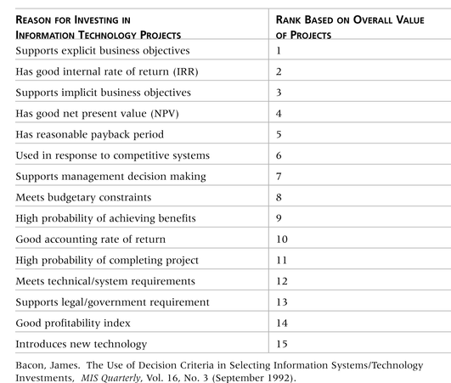
Table 4-1. Why Firms Invest in Information Technology

Slide 7
Identifying Potential Projects
Many organizations follow a planning process for selecting IT projects
First develop an IT strategic plan based on the organization’s overall strategic plan
Then perform a business area analysis
Then define potential projects
Then select IT projects and assign resources

Slide 8
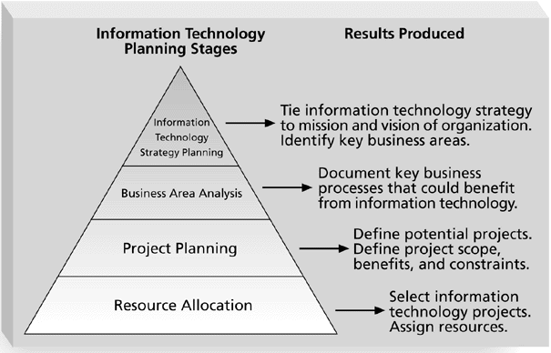
Figure 4-1. Information Technology Planning Process

Slide 9
Methods for Selecting Projects
There are usually more projects than available time and resources to implement them
It is important to follow a logical process for selecting IT projects to work on
Methods include focusing on broad needs, categorizing projects, financial methods, and weighted scoring models

Slide 10
Focusing on Broad Organizational Needs
It is often difficult to provide strong justification for many IT projects, but everyone agrees they have a high value
“It is better to measure gold roughly than to count pennies precisely”
Three important criteria for projects:
  There is a need for the project
  There are funds available
  There’s a strong will to make the project succeed

Slide 11
Categorizing IT Projects
One categorization is whether the project addresses
  a problem
  an opportunity, or
  a directive
Another categorization is how long it will take to do and when it is needed
Another is the overall priority of the project

Slide 12
Financial Analysis of Projects
Financial considerations are often an important consideration in selecting projects
Three primary methods for determining the projected financial value of projects:
  Net present value (NPV) analysis
  Return on investment (ROI)
  Payback analysis

Slide 13
Net Present Value Analysis
Net present value (NPV) analysis is a method of calculating the expected net monetary gain or loss from a project by discounting all expected future cash inflows and outflows to the present point in time
Projects with a positive NPV should be considered if financial value is a key criterion
The higher the NPV, the better

Slide 14
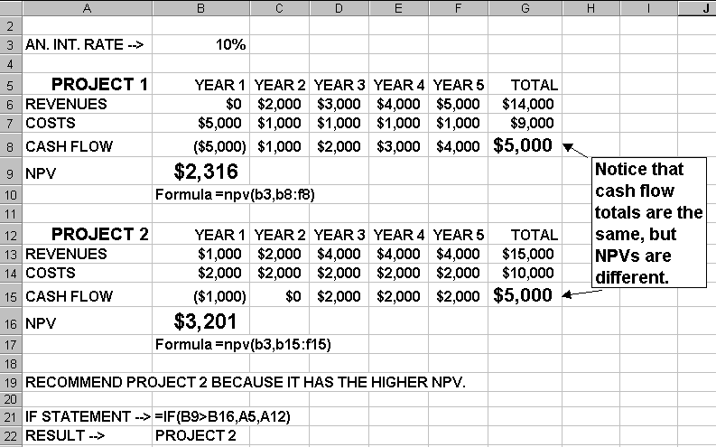
Figure 4-2. Net Present Value Example
Excel file

Slide 15
Return on Investment
Return on investment (ROI) is income divided by investment
  ROI = (total discounted benefits - total discounted costs) / discounted costs
The higher the ROI, the better
Many organizations have a required rate of return or minimum acceptable rate of return on investment for projects

Slide 16
Payback Analysis
Another important financial consideration is payback analysis
The payback period is the amount of time it will take to recoup, in the form of net cash inflows, the net dollars invested in a project
Payback occurs when the cumulative discounted benefits and costs are greater than zero
Many organizations want IT projects to have a fairly short payback period

Slide 17
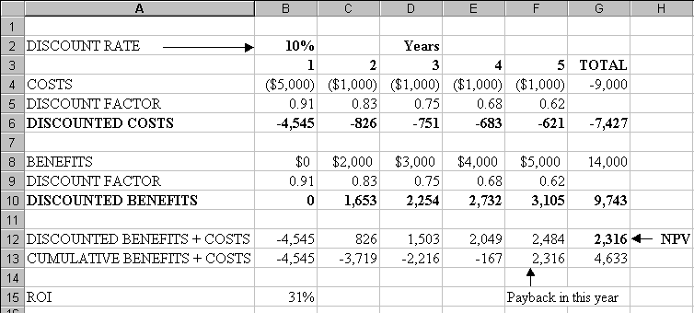
Figure 4-3. NPV, ROI, and Payback Analysis for Project 1
Excel file

Slide 18
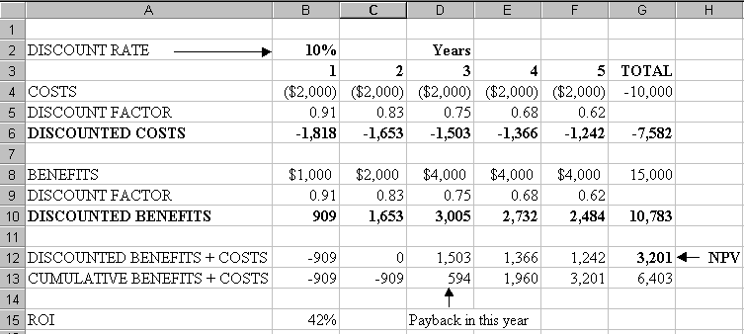
Figure 4-4. NPV, ROI, and Payback Analysis for Project 2
Excel file

Slide 19
Weighted Scoring Model
A weighted scoring model is a tool that provides a systematic process for selecting projects based on many criteria
  First identify criteria important to the project selection process
  Then assign weights (percentages) to each criterion so they add up to 100%
  Then assign scores to each criterion for each project
  Multiply the scores by the weights and get the total weighted scores
The higher the weighted score, the better
See “What Went Right?” for a description of how a mortgage finance agency uses a weighted scoring model for IT projects

Slide 20
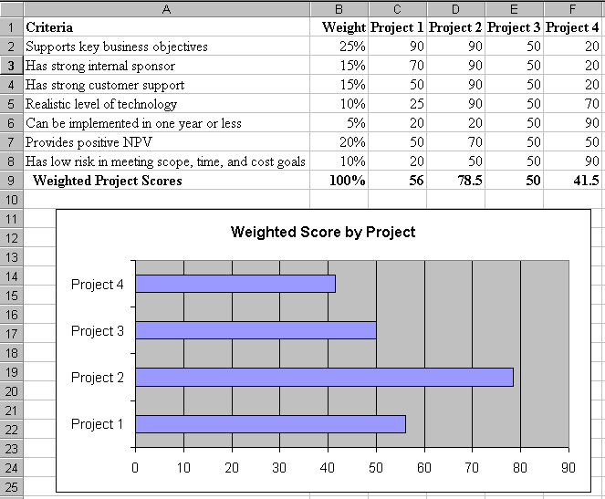
Figure 4-5. Sample Weighted Scoring Model for Project Selection
Excel file

Slide 21
Project Charters
After deciding what project to work on, it is important to formalize projects
A project charter is a document that formally recognizes the existence of a project and provides direction on the project’s objectives and management
Key project stakeholders should sign a project charter to acknowledge agreement on the need and intent of the project

Slide 22
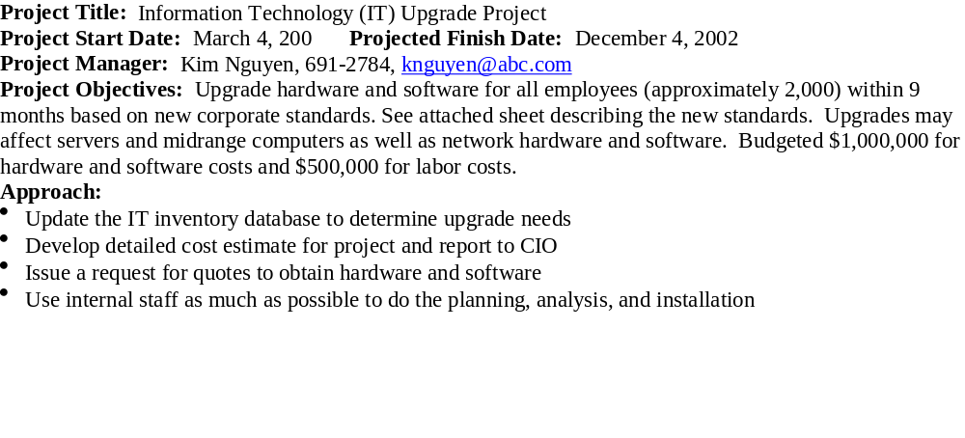
Table 4-2. Sample Project Charter

Slide 23
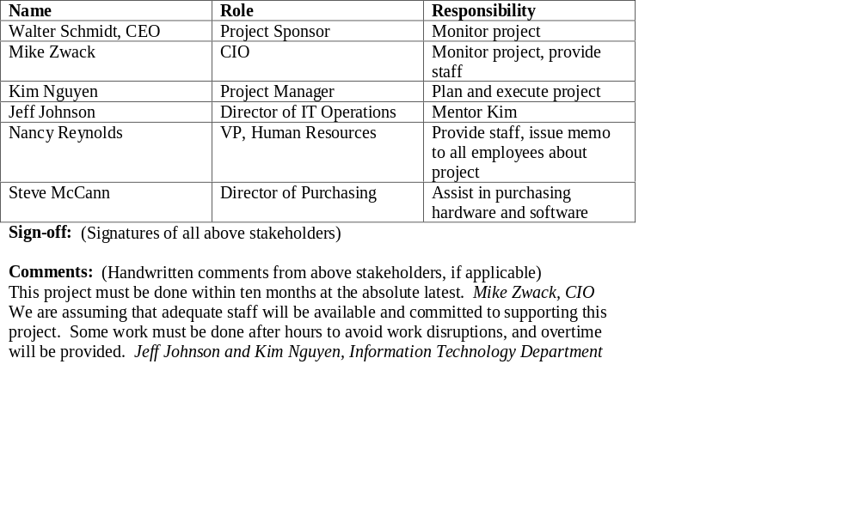
Table 4-2. Sample Project Charter (continued)
Roles and Responsibilities:

Slide 24
Scope Planning and the Scope Statement
A scope statement is a document used to develop and confirm a common understanding of the project scope. It should include
  a project justification
  a brief description of the project’s products
  a summary of all project deliverables
  a statement of what determines project success

Slide 25
Scope Planning and the Work Breakdown Structure
After completing scope planning, the next step is to further define the work by breaking it into manageable pieces
Good scope definition
  helps improve the accuracy of time, cost, and resource estimates
  defines a baseline for performance measurement and project control
  aids in communicating clear work responsibilities

Slide 26
The Work Breakdown Structure
A work breakdown structure (WBS) is an outcome-oriented analysis of the work involved in a project that defines the total scope of the project
It is a foundation document in project management because it provides the basis for planning and managing project schedules, costs, and changes

Slide 27
Figure 4-6a. Sample Intranet WBS Organized by Product

Slide 28
Table 4-3. Intranet WBS in Tabular Form
1.0 Concept
1.1 Evaluate current systems
1.2 Define Requirements
1.2.1 Define user requirements
1.2.2 Define content requirements
1.2.3 Define system requirements
1.2.4 Define server owner requirements
1.3 Define specific functionality
1.4 Define risks and risk management approach
1.5 Develop project plan
1.6 Brief web development team
2.0 Web Site Design
3.0 Web Site Development
4.0 Roll Out
5.0 Support

Slide 29
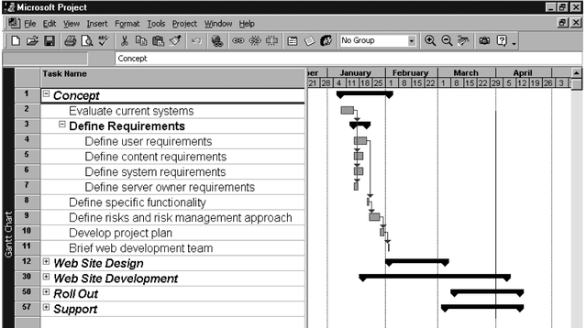
Figure 4-7. Intranet WBS and Gantt Chart in Project 2000
Project 98 file

Slide 30
Approaches to Developing WBSs
Using guidelines: Some organizations, like the DOD, provide guidelines for preparing WBSs
The analogy approach: It often helps to review WBSs of similar projects
The top-down approach: Start with the largest items of the project and keep breaking them down
The bottoms-up approach: Start with the detailed tasks and roll them up

Slide 31
Scope Verification and Scope Change Control
It is very difficult to create a good scope statement and WBS for a project
It is even more difficult to verify project scope and minimize scope changes
Many IT projects suffer from scope creep and poor scope verification
  FoxMeyer Drug filed for bankruptcy after scope creep on a robotic warehouse
  Engineers at Grumman called a system “Naziware” and refused to use it

Slide 32
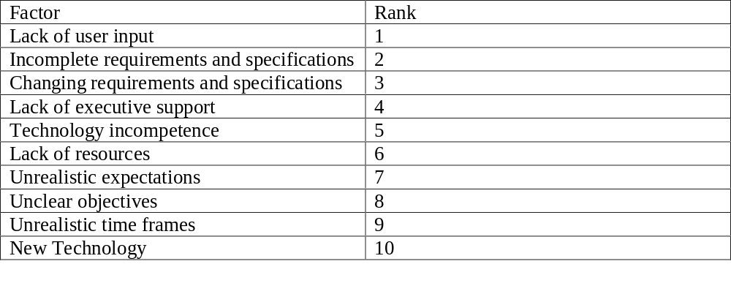
Table 4-4. Factors Causing IT Project Problems*
*Johnson, Jim. CHAOS: The Dollar Drain of Information Technology Project Failures,” Application Development Trends (January 1995) www.standishgroup.com/chaos.html
*Johnson, Jim, "CHAOS: The Dollar Drain of IT Project Failures," Application Development Trends, January 1995, www.stadishgroup.com/chaos.html

Slide 33
Suggestions for Improving User Input
Insist that all projects have a sponsor from the user organization
Have users on the project team
Have regular meetings
Deliver something to project users and sponsor on a regular basis
Co-locate users with the developers

Slide 34
Suggestions for Reducing Incomplete and Changing Requirements
Develop and follow a requirements management process
Employ techniques such as prototyping, use case modeling, and Joint Application Design to thoroughly understand user requirements
Put all requirements in writing and current
Create a requirements management database
Provide adequate testing
Use a process for reviewing requested changes from a systems perspective
Emphasize completion dates

